Slide 1
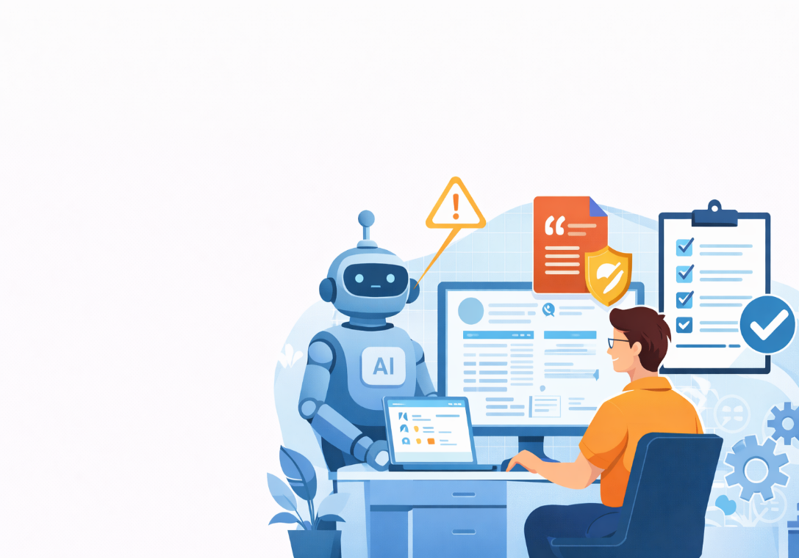
How to Use AI Responsibly
Hallucinations, Plagiarism & Safe Academic Practice
ZESS – Zentrale Einrichtung für
Sprachen und Schlüsselqualifikationen
AI knowledge nuggets
Dr. rer. nat. Aisha Aamir
Digitale Kompetenzen (ZESS-IT)
Notes:
This session introduces how AI tools such as ChatGPT, Copilot, or Gemini should be used responsibly in academic contexts at the University of Göttingen.
The goal is not to discourage AI use, but to help you understand its limitations, risks, and safe practices.
AI tools are increasingly common in studying, teaching, and research. However, misunderstanding how they work can lead to false information, plagiarism, or academic misconduct.
By the end of this session, you should feel confident using AI as support, not as a replacement for your own academic work.

Slide 2
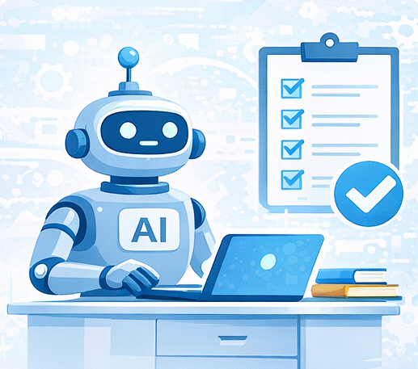
Learning Goal
ZESS – Zentrale Einrichtung für
Sprachen und Schlüsselqualifikationen
At the end of this Nugget, you can:
Describe what AI systems can and cannot do
Recognize typical AI hallucinations
Identify plagiarism risks when using AI tools
Apply strategies to verify and safely use AI in academic work

Slide 3
What AI Systems Can and Cannot Do
ZESS – Zentrale Einrichtung für
Sprachen und Schlüsselqualifikationen
AI is good at:
Explaining concepts in simple language
Summarizing texts
Generating drafts or ideas
Rephrasing sentences
Helping brainstorm structure (outlines, headings)
Important:
AI works by predicting patterns in language, not by understanding meaning.
AI cannot:
Think critically like a human
Understand context the way you do
Judge truth or correctness
Know university rules or exam regulations
Replace your responsibility as an author
Key warning:
AI can sound confident even when it is wrong
Notes:
What AI Can Do
AI systems are very good at working with language patterns. They can explain topics in simpler words, summarize long texts, suggest ideas, and help organize content logically.
This makes them useful for learning support, especially when starting a new topic or improving clarity.
However, it is important to understand how AI does this.
AI does not understand meaning like a human. Instead, it predicts which words are likely to come next based on training data.
This is why AI can sound fluent and confident — even when the content is inaccurate.
What AI Systems Cannot Do
AI systems have important limitations. They cannot think critically, reflect on context, or evaluate truth in the way we humans do.
They also do not know university-specific rules, exam regulations, or course requirements unless explicitly provided — and even then, they may misunderstand them.
A key risk is that AI may produce answers that sound very confident but are factually wrong.
This means responsibility always stays with the human user.
If an AI-generated answer is incorrect, it is your responsibility, not the AI’s.

Slide 4
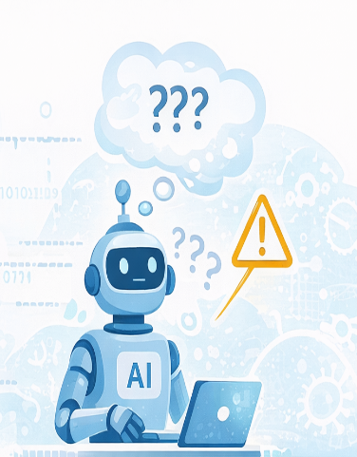
What Are AI Hallucinations?
ZESS – Zentrale Einrichtung für
Sprachen und Schlüsselqualifikationen
Hallucination = confident but incorrect output
Examples:
Made-up scientific references
Invented authors, years, or journal names
False statistics or claims
Incorrect explanations that sound plausible
Why hallucinations happen:
AI predicts text → it does not check facts
If information is missing, AI may guess
Notes:
An AI hallucination occurs when an AI produces information that is confidently stated but incorrect or entirely fabricated.
This is not intentional — it happens because AI systems do not verify facts.
Typical hallucinations include invented references, fake authors, incorrect statistics, or explanations that sound reasonable but are wrong.
Hallucinations often occur when AI lacks reliable information or when a question is vague.
Understanding hallucinations is essential because they are not always obvious.

Slide 5
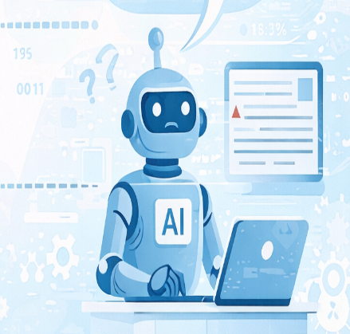
Typical Hallucination Examples
ZESS – Zentrale Einrichtung für
Sprachen und Schlüsselqualifikationen
Common warning signs:
References that cannot be found online
Citations with correct formatting but fake content
Quotes without page numbers
Statements like:
“According to a study by Smith et al. 2021”
(but no real study exists)
Rule of thumb:
If you did not verify it, do not trust it
Notes:
Some hallucinations look very academic on the surface. For example, AI may generate references with correct formatting, realistic journal names, and plausible years — but the paper does not exist.
A common red flag is a reference that cannot be found in Google Scholar or publisher databases.
Another warning sign is a quotation without page numbers or precise source details.
A simple rule applies here:
If you did not verify it yourself, you should not trust it.

Slide 6
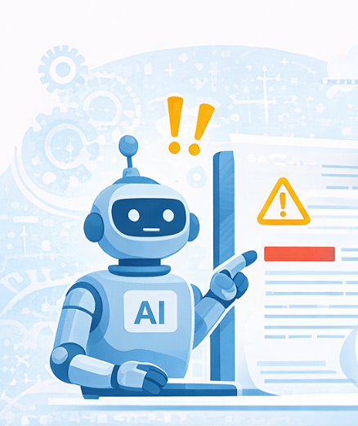
Plagiarism Risks When Using AI
ZESS – Zentrale Einrichtung für
Sprachen und Schlüsselqualifikationen
Important:
Using AI text without proper handling can still be plagiarism
Risks include:
Submitting AI-generated text as your own
Copy-pasting AI output without revision
Using AI to paraphrase without understanding
Relying on AI-generated citations
Even if AI wrote it — YOU are responsible
Notes:
Many students assume that AI-generated text is automatically plagiarism-free. This is not true.
Plagiarism can occur if you submit AI-generated content as your own work, copy AI output without revision, or use AI to paraphrase material you do not understand.
Even if the text is original in wording, the academic responsibility remains yours.
From an academic integrity perspective, the question is not who wrote the text, but who claims authorship.

Slide 7

What Counts as Safe Academic AI Use?
ZESS – Zentrale Einrichtung für
Sprachen und Schlüsselqualifikationen
Generally acceptable:
Brainstorming ideas
Improving language clarity
Creating outlines
Getting explanations for difficult concepts
Usually NOT acceptable:
Writing full assignments or exams
Generating references without checking
Submitting AI output unchanged
Hiding AI usage when disclosure is required
Notes:
Acceptable Use:
In many academic contexts, AI use is acceptable when it supports learning rather than replaces it.
Examples include brainstorming ideas, improving language clarity, structuring essays, or getting explanations for difficult concepts.
These uses are considered assistive, similar to using a dictionary or grammar tool — provided you still do the intellectual work yourself.
Always check course-specific or faculty guidelines, as rules may differ.
What Is Usually NOT Acceptable:
Using AI to write full assignments, generate exam answers, or produce references without verification is generally not acceptable in academic work.
Submitting AI output unchanged or hiding AI usage when disclosure is required can be considered academic misconduct.
Transparency is key: when in doubt, ask your instructor or supervisor.

Slide 8
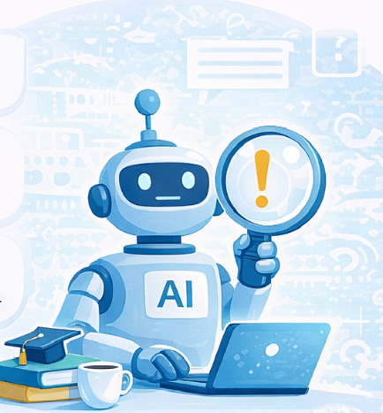
How to Verify AI Output (Practical Strategy)
ZESS – Zentrale Einrichtung für
Sprachen und Schlüsselqualifikationen
Before using AI content, always:
Cross-check facts
  Google Scholar
  PubMed
  Publisher websites
Verify references manually
  Does the paper really exist?
  Are the authors and years correct?
3. Rewrite in your own words
  Use AI as input, not final output
4. Ask AI to explain its answer
  Weak explanations = warning sign
Notes:
Before using any AI-generated academic content, verification is essential.
Facts should be cross-checked using reliable sources such as Google Scholar, PubMed, or official publisher websites.
References must be checked manually to confirm that the paper exists and that authors, years, and journals are correct.
AI should be treated as a starting point, never as a final authority.
A good practice is to always rewrite AI output in your own words.
This ensures understanding and reduces plagiarism risk.
You can also test AI reliability by asking it to explain why something is true.
If the explanation is vague, circular, or inconsistent, that is a warning sign that the content may not be reliable.

Slide 9
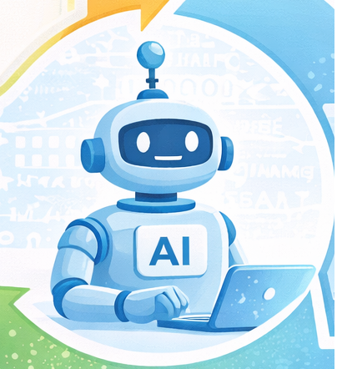
Responsible AI Use: A Simple Model
ZESS – Zentrale Einrichtung für
Sprachen und Schlüsselqualifikationen
Think of AI as:
A navigation aid — not the driver
You decide:
What question to ask
What to keep
What to reject
What to verify
Good academic practice = Human judgment + AI support
Notes:
Think of AI as a navigation aid — like a GPS.
It can suggest routes, but you are still driving the car.
You decide what questions to ask, which answers to accept, which to reject, and what needs verification.
Responsible academic AI use combines human judgment with AI support.

Slide 10
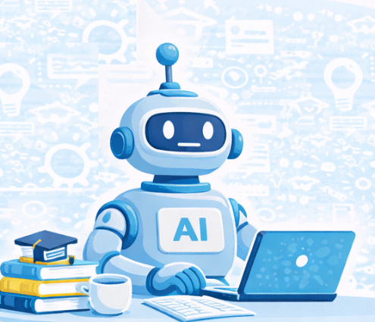
Self-Practice Task
ZESS – Zentrale Einrichtung für
Sprachen und Schlüsselqualifikationen
Choose any AI Tool: ChatGPT, Copilot, Gemini, Jenni, etc.
Ask an AI tool:
Provide three peer‑reviewed scientific references related to your preferred research topic [insert topic here]
Choose one reference and:
  Check if it exists on Google Scholar, Semantic Scholar, or any known academic journals of your choice.
  Verify authors, year, and journal
  Reflect:
      Was the reference real or hallucinated?
      Would you trust AI citations without checking?
Optional Reflection Question:
  How would you safely use AI for your next assignment?
Notes:
This short practice task helps you apply what you have learned.
Choose any AI tool and ask it to provide three peer-reviewed references related to your own research or study topic.
Then select one reference and verify whether it truly exists using academic databases.
Reflect on whether the reference was real or hallucinated and consider whether you would trust AI-generated citations without checking.
This exercise builds a habit of critical verification, which is essential for safe academic AI use.

